Slide 1
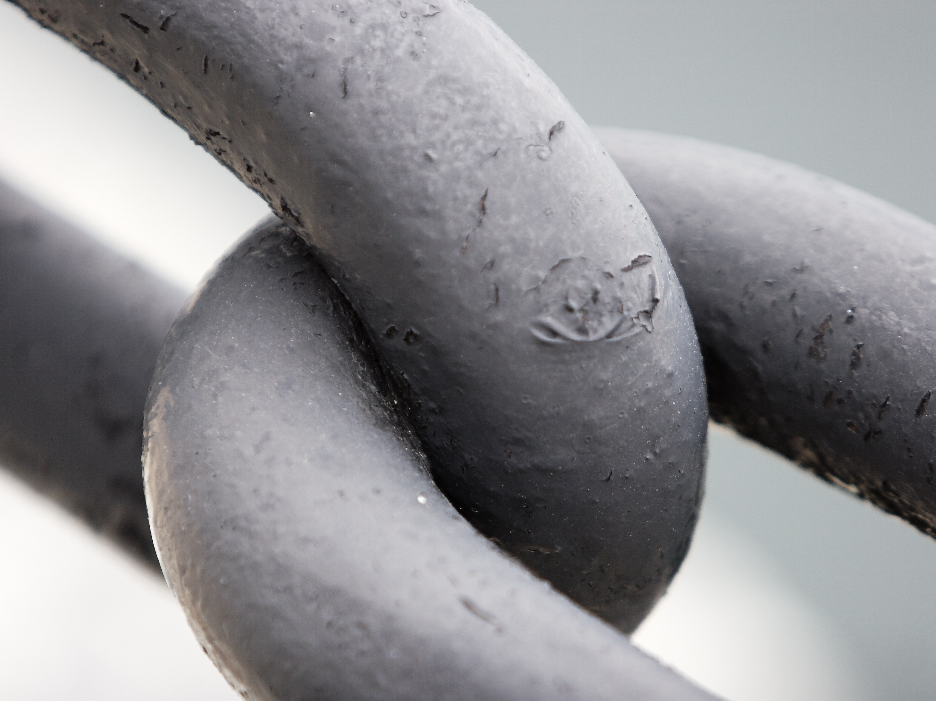
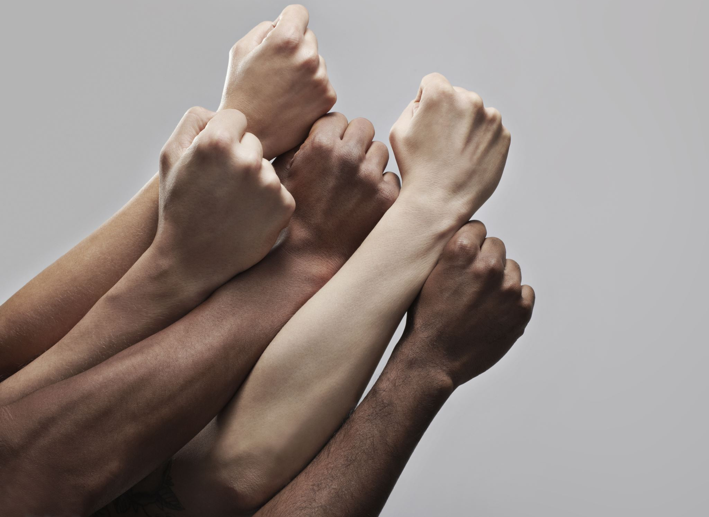
Week 6: Interjections, utterances, and cohesion
Ryan Ka Yau Lai
University of California, Santa Barbara

Slide 2

Before we start …
Open sbc007.rez
If you have a file saved from previous classes, please open that
If not, just open sbc007
Also, please go to Google Drive and download unit_anno.json from section materials
And take note of the question + codeword on the board!

Slide 3
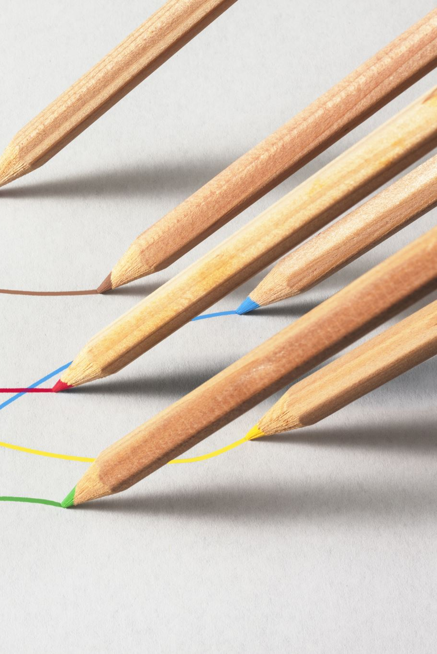
Today’s question
Choose one interjection in SBC007 (other than the examples we’ve discussed)
How does the interjection relate to the previous and/or following material?
[You will be able to do this during the activity]

Slide 4
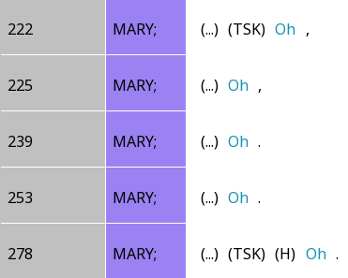
Where do we use interjections?
1. In one-word, holistic IUs

Slide 5
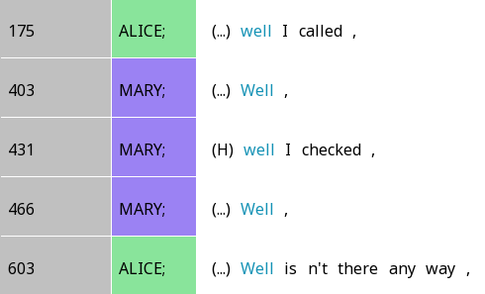
Where do we use interjections?
2. At the beginnings of multi-word IUs

Slide 6
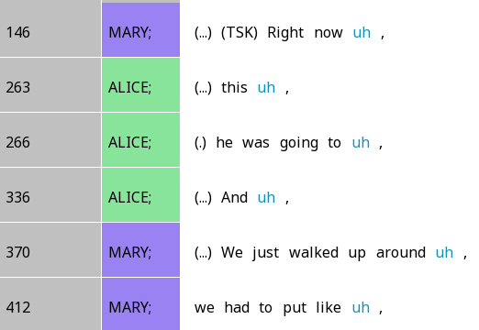
Where do we use interjections?
3. At the ends of multi-word IUs

Slide 7

Interjections connect different parts of discourse together!
They have ‘meaning’
They are important
But what work do they do?

Slide 8
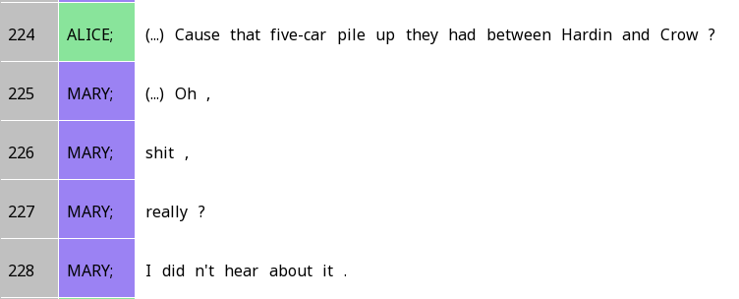
Interjections as ‘prefacing’
Interjections often appear at the beginning of a turn (when you start speaking)
Responds to the previous turn
Prepares for more substantive parts of the turn

Slide 9
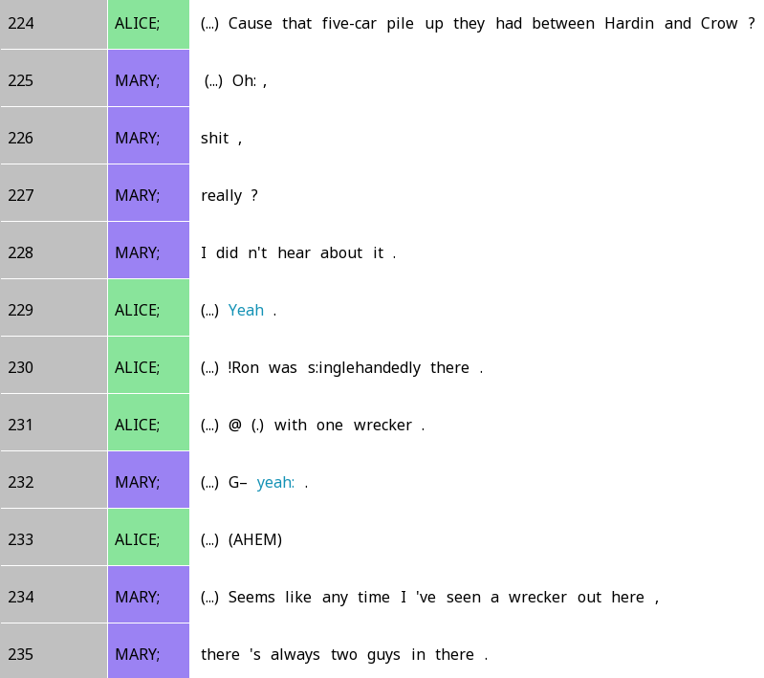

A tale of two ‘yeah’s
What do the two yeahs have in common?
How are they different?

Slide 10
A tale of two ‘yeah’s
Both respond to the previous discourse
Alice confirms the five-car pile-up after Mary expresses surprise
Mary’s ‘yeah’ not just confirms understanding, but also expresses surprise at Ron being alone – which she expands upon later

Slide 11
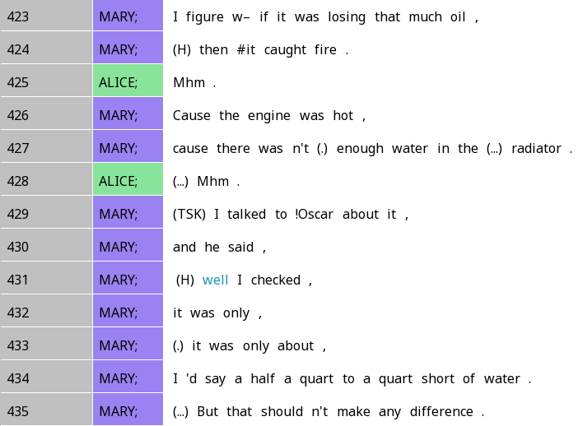
How about ‘well’?
How does this relate to the previous and following context?

Slide 12
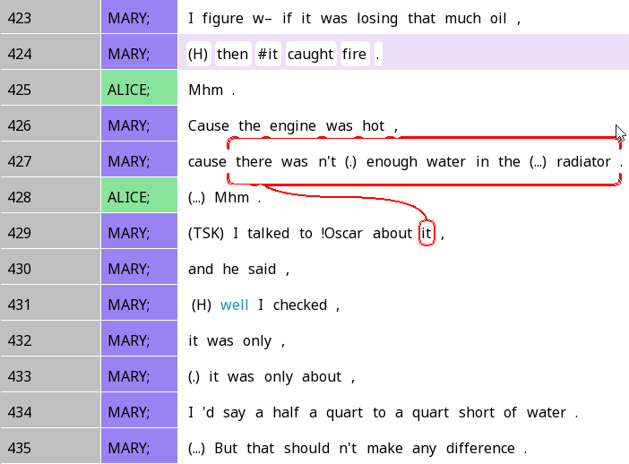
How about ‘well’?
‘Well’ typically tells us that what’s gonna come is going to not quite what you expect!

Slide 13
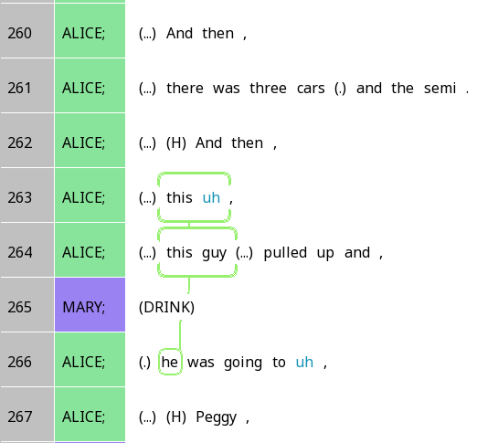
Fillers as interjections
Fillers help us hold the floor while planning speech
How does this relate to accessibility? (cf. Arnold reading)

Slide 14
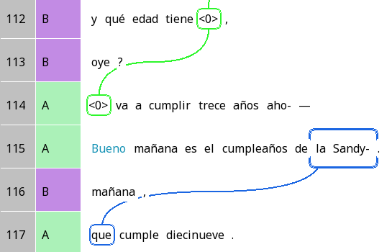
Is ‘bueno’ always ‘good’?
And how old is she,
hear?
What is ‘bueno’ doing here?
(Hint: Look at the trails!)
She’s gonna be thirteen n-
Bueno tomorrow is Sandy’s birthday.
Tomorrow.
Who turns nineteen.

Slide 15
Is ‘bueno’ always ‘good’?
And how old is she,
hear?
Bueno is indicating a slight change in the topic
She’s gonna be thirteen n-
Bueno tomorrow is Sandy’s birthday.
Tomorrow.
Who turns nineteeen.

Slide 16
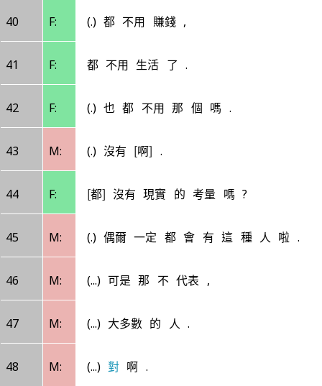
Is ‘對’ duì always ‘right’?
They don’t have to earn money at all
Don’t have to live at all
Don’t have to that kind of thing?
Hint: The pause before 對 is very long
Nah
Don’t they have real-life considerations?
There will always be this kind of person occasionally.
But that doesn’t represent,
The majority of people.
Duì.

Slide 17
Is ‘對’ duì always ‘right’?
They don’t have to earn money at all
Don’t have to live at all
Don’t have to that kind of thing?
對啊 is marking the end of M’s turn, and telling F she can speak
Nah
Don’t they have real-life considerations?
There will always be this kind of person occasionally.
But that doesn’t represent,
The majority of people.
Duì.

Slide 18
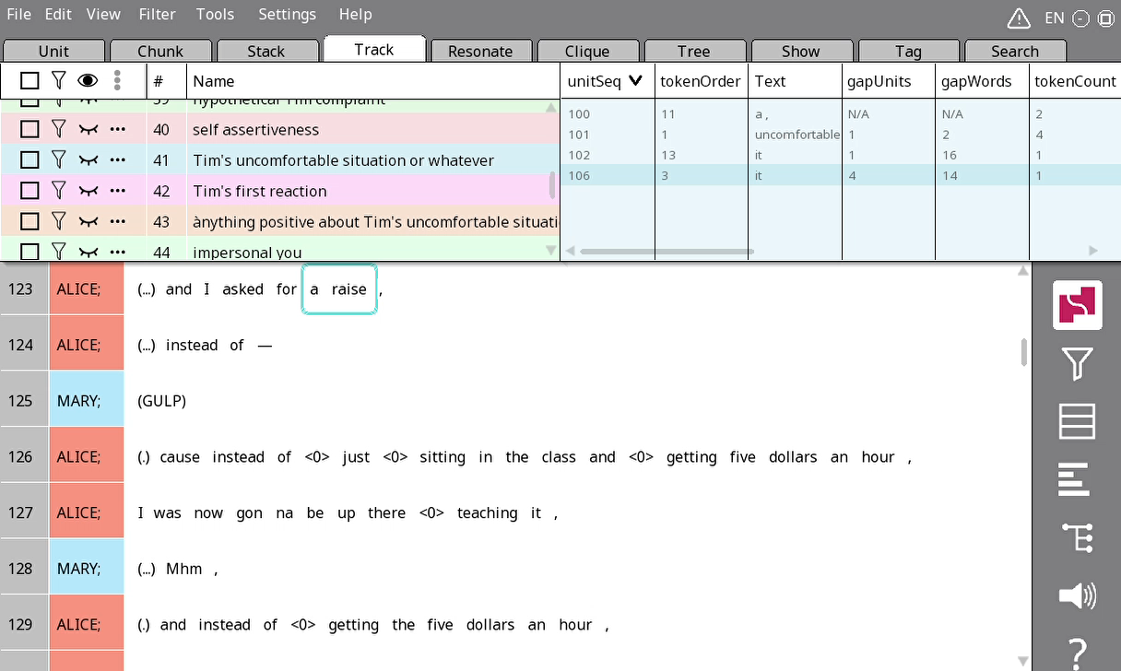
Searching
Go to the Search tab
Click on the green + line
Select a search field; for today, just leave it as Text
Click OK

Slide 19
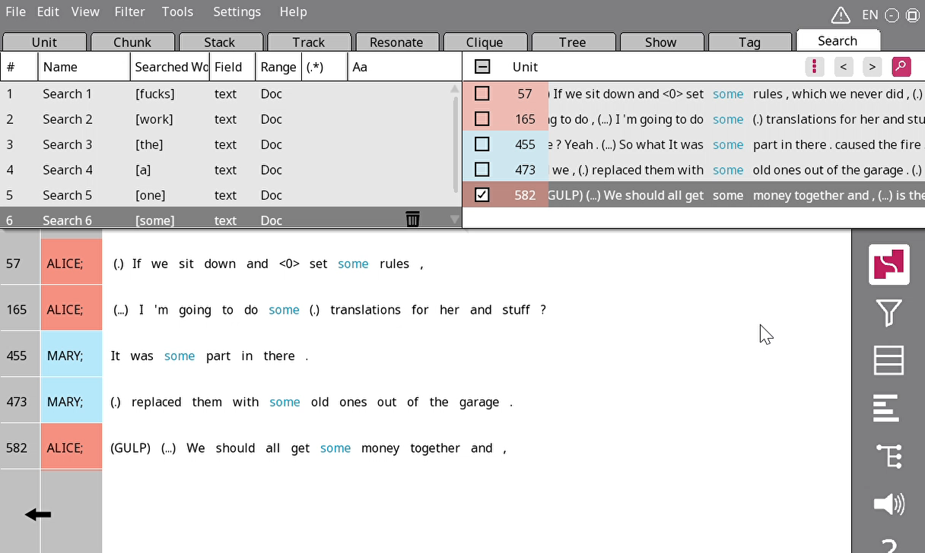
Sifting through search results
Click on the magnifying glass in the corner
On the right side of the nav window, click on a line that looks interesting
The main screen should now show the context of that example

Slide 20
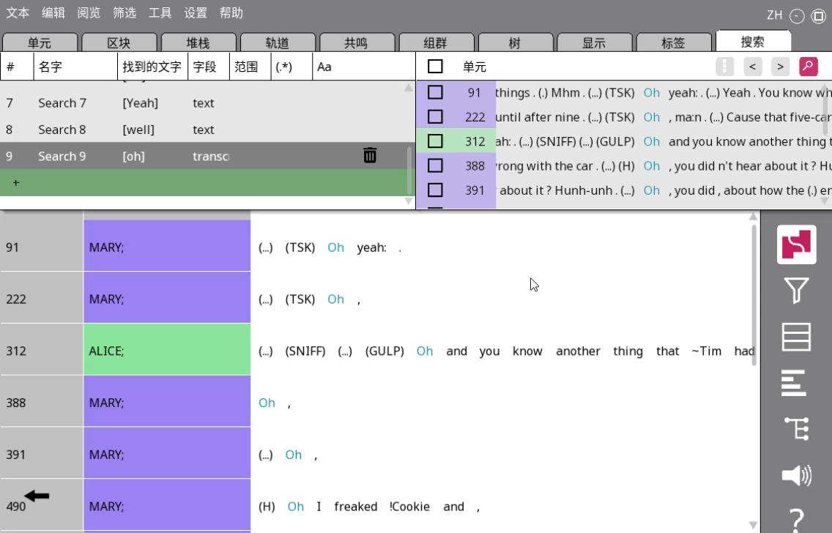

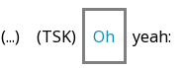
Marking up interjections
Click on the mode icon and change it to tag mode (the pencil)
Click and drag on an interjection to create a grey ‘blank chunk’

Slide 21

Your turn!
Find two instances of the same interjection in the text (e.g. yeah, well, uh) using the Search feature and mark them with the grey border
Put the interjection and the contexts it’s responding to or projecting in a stack, and make a show with your two stacks
Tell us the relationship between the interjection and its previous context, following context, or both
Do you think the function of the interjection is similar in both cases?
[You may complete your attendance question now]

Slide 22
Four types of endnotes
,
Continuing (‘comma’, stable)
?
Appeal (‘question mark’, rising)
.
Terminating (‘period’, falling)
--
Truncation (‘dash’, when you feel the IU was not finished)

Slide 23
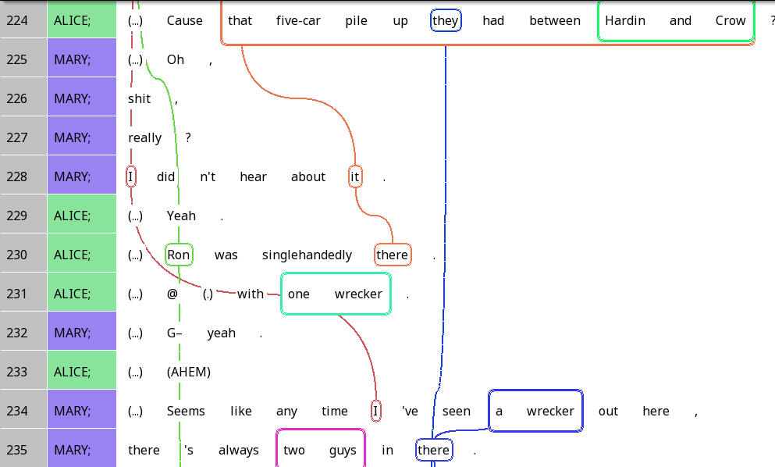
Continuing intonation - stable

Slide 24
Appeal (question) intonation - rising

Slide 25
Terminating intonation - falling

Slide 26
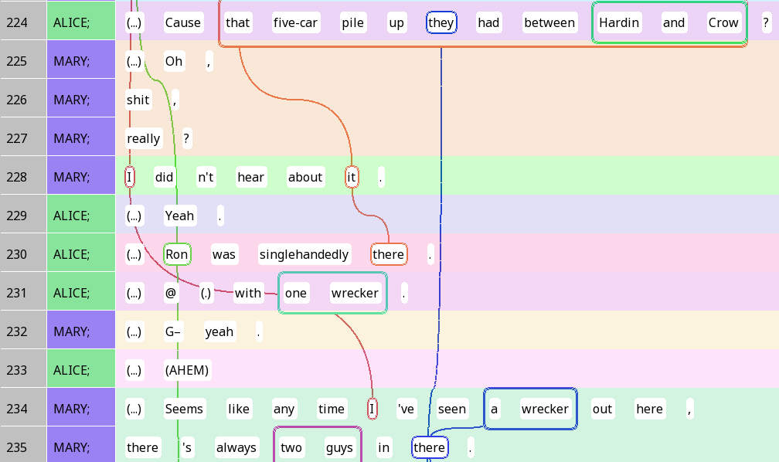
Prosodic utterances
Continuing intonation: We’re not done yet
Appeal/Terminating (closure): We’re done with this point

Slide 27
Prosodic utterances & ‘sentences’
Are prosodic utterances equivalent to sentences?

Slide 28
Prosodic utterances & ‘sentences’
Are prosodic utterances equivalent to sentences?

Slide 29
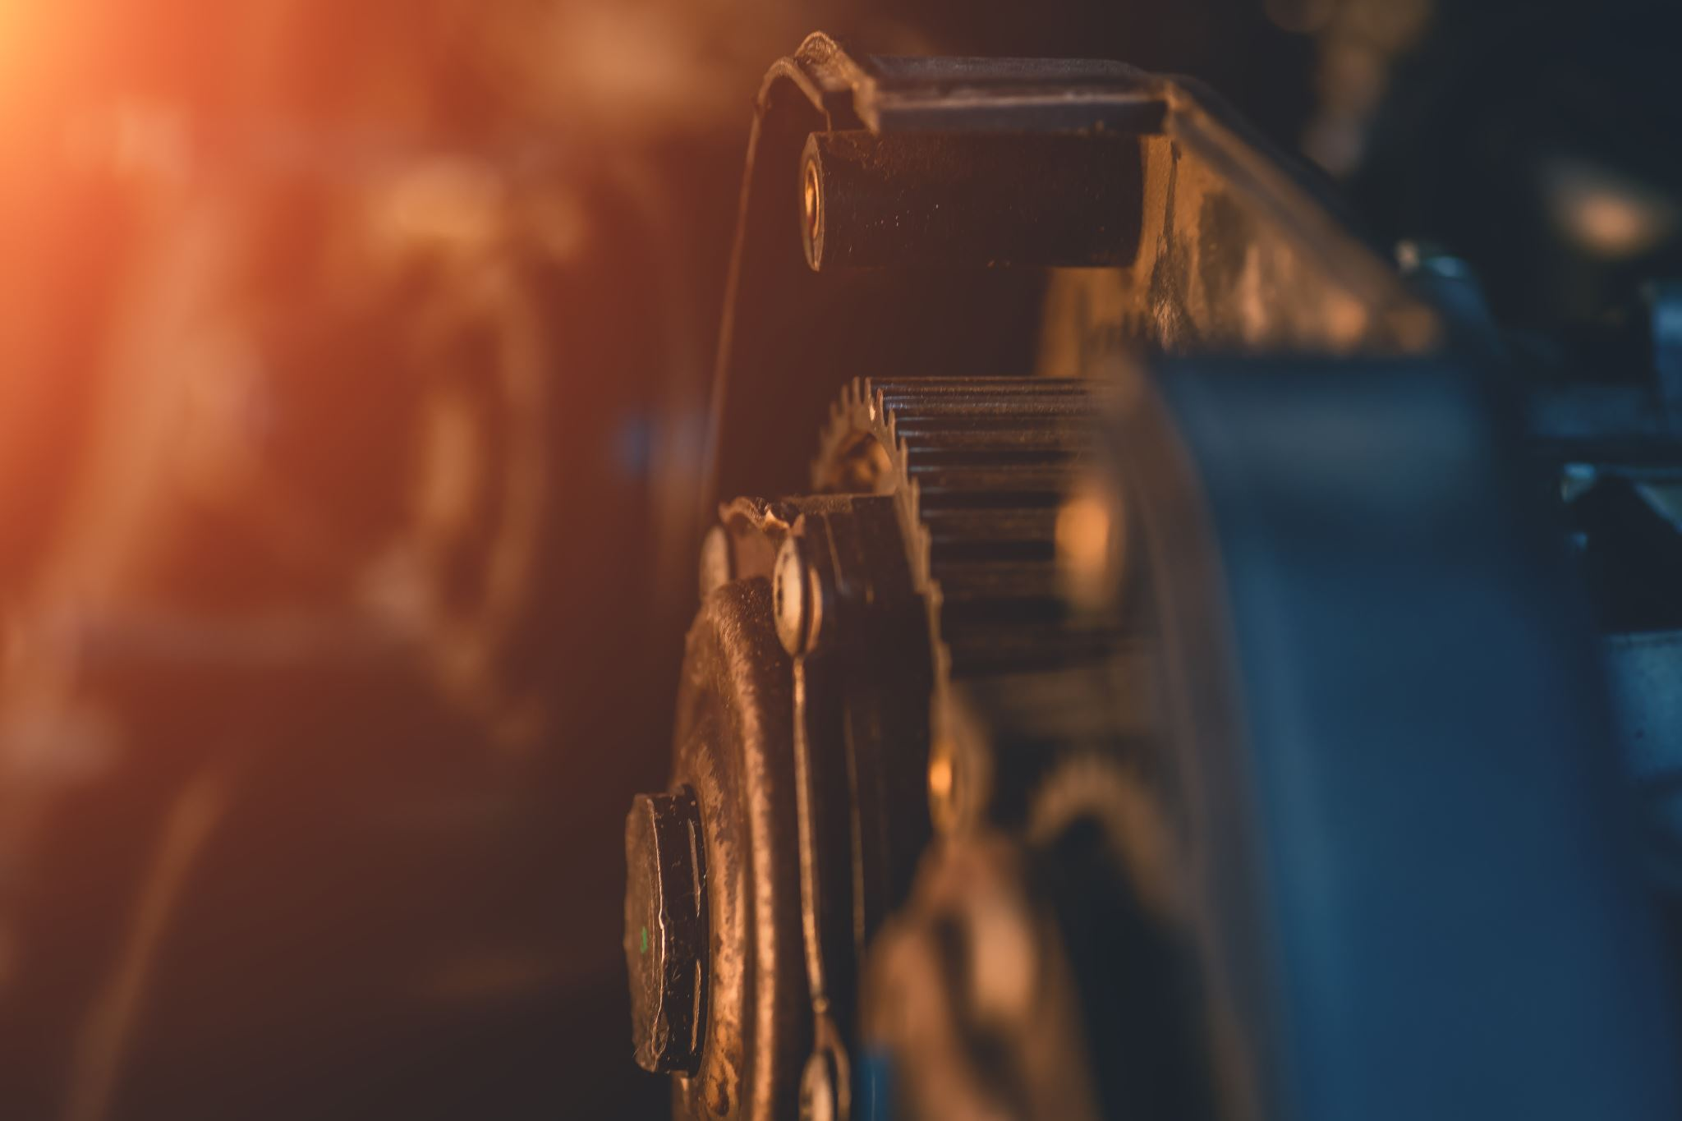
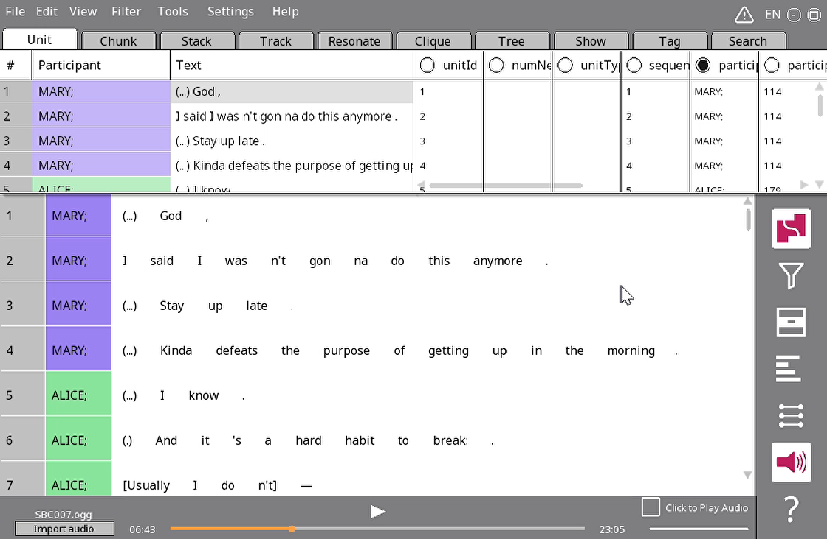
The utterance stacker
Open SBC002
Tools > Stacker > Utterance
Click OK
Wait a few seconds
Each stack is now a prosodic utterance

